Slide 1
Machine Learning
Google Colab Tutorial Medium
微信 : ai_ai360
2021.03.09

Slide 2
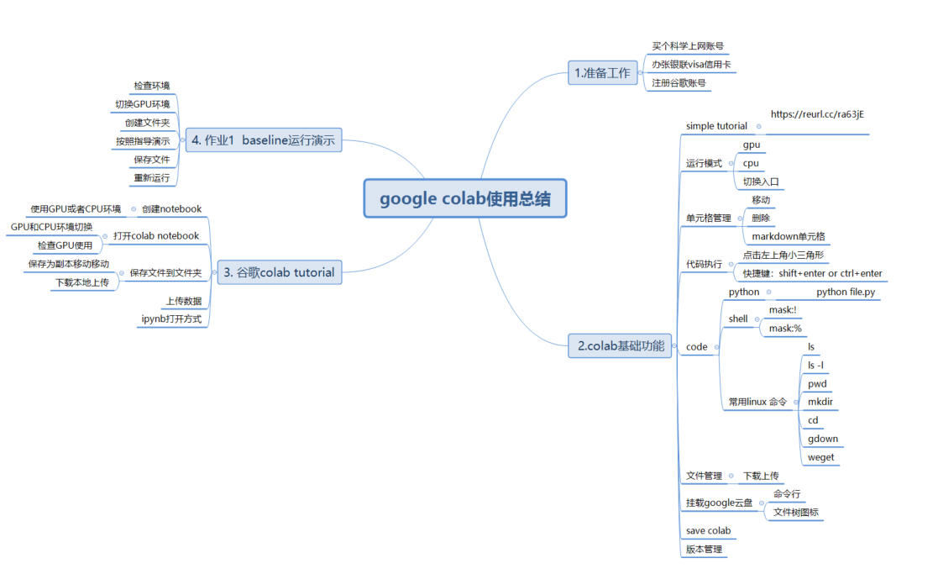
Outline

Slide 3
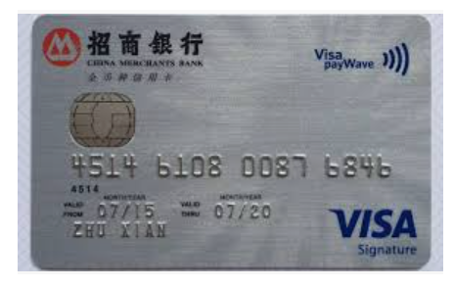
Preparation
注册谷歌账号
办银联标志visa信用卡
买个科学上网账号
下载谷歌浏览器

Slide 4
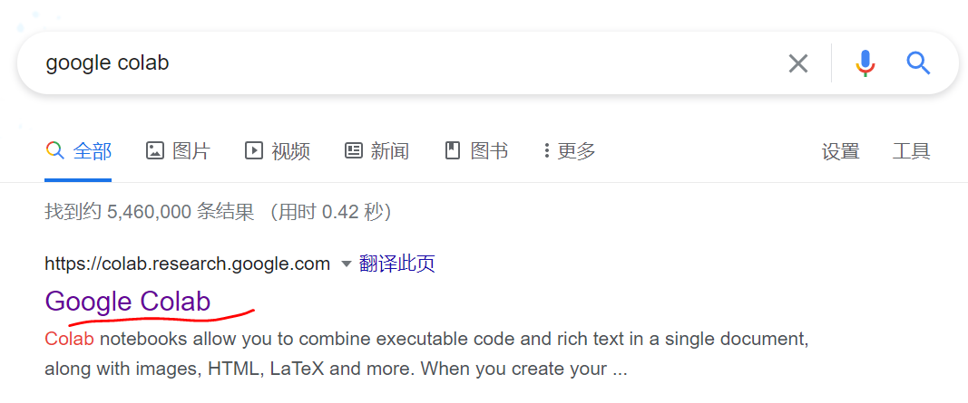
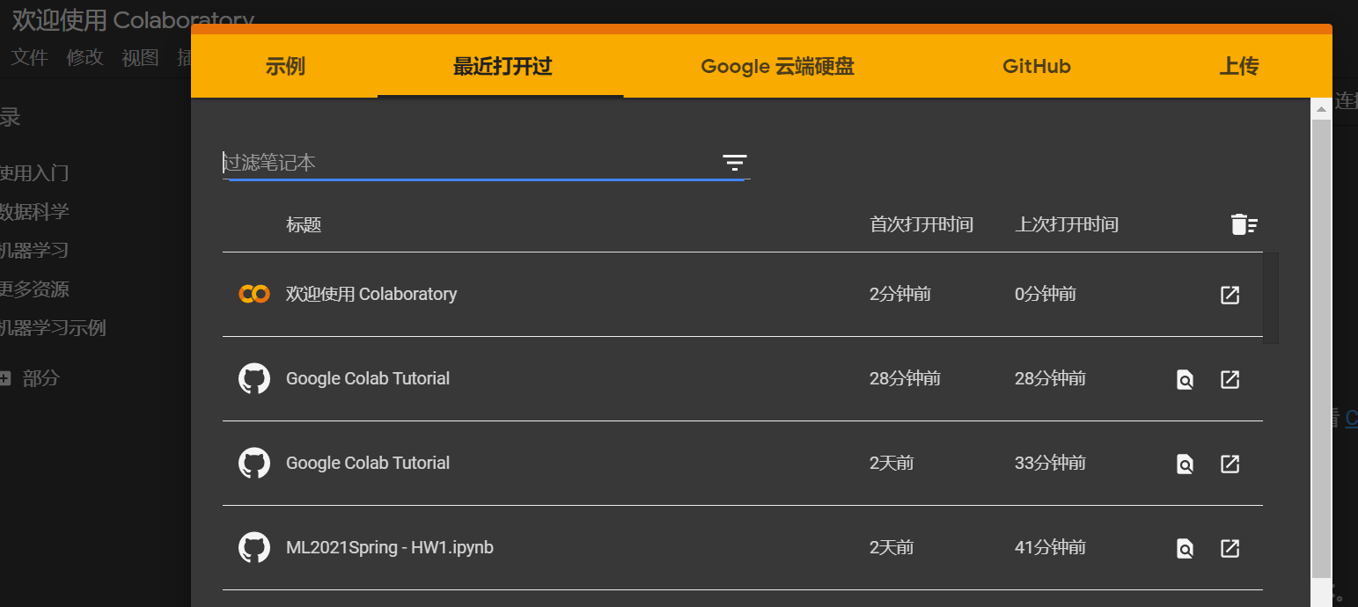
Preparation
首次使用google colab

Slide 5
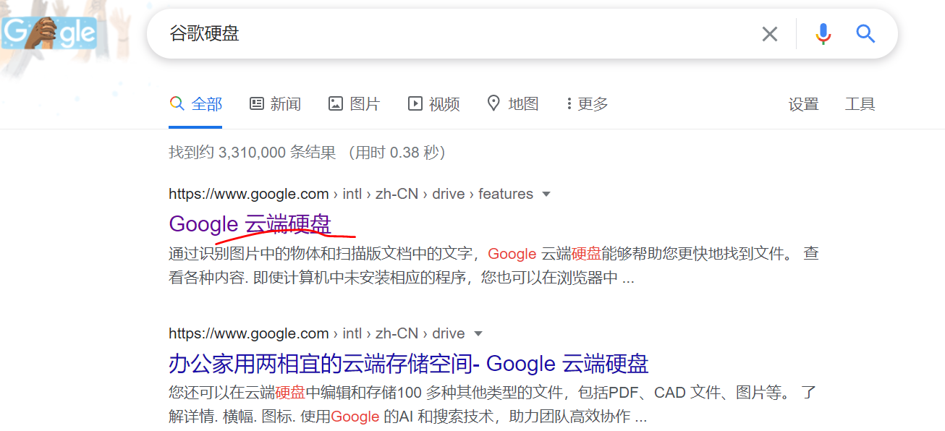
Preparation
谷歌账号添加硬盘

Slide 6
Introduction
Colaboratory, or "Colab" for short, allows you to write and execute Python in your browser, with
Zero configuration required
Free access to GPUs
Easy sharing

Slide 7
Introduction
Colab Demo : https://reurl.cc/ra63jE
In this demo, your will learn the following :
Download files using colab
Connect google colab with your google drive
Pytorch examples and common errors

Slide 8
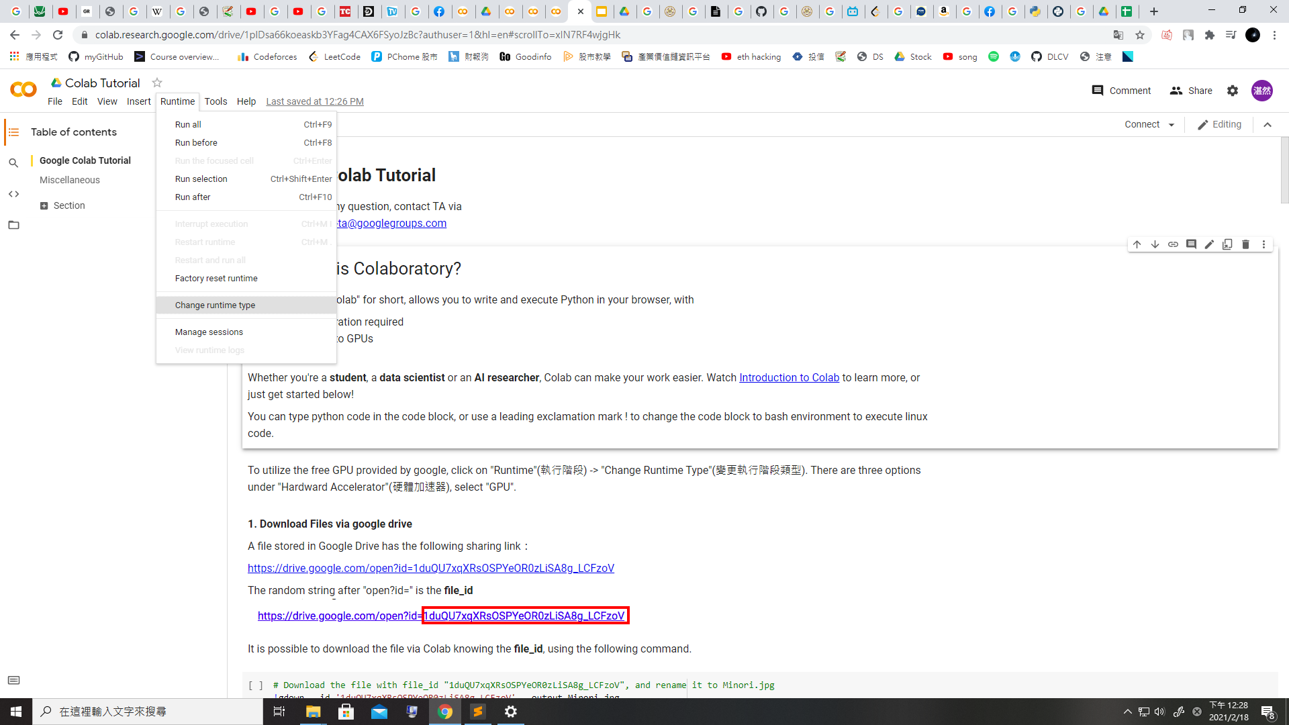
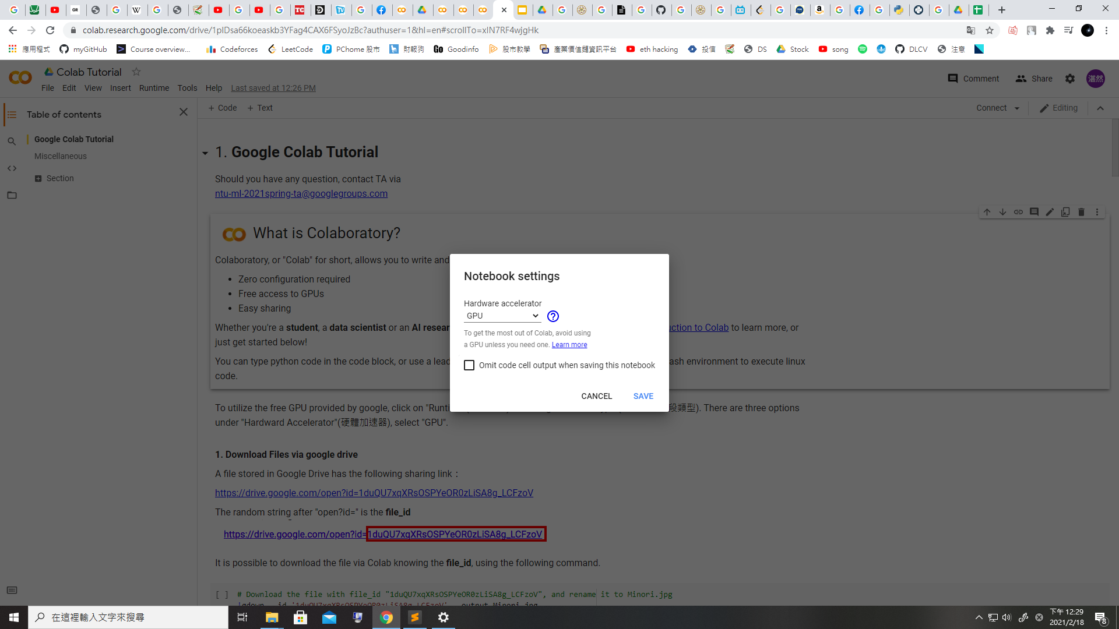
Changing Runtime
To utilize the free GPU provided by google, click on "Runtime"(執行階段) -> "Change Runtime Type"(變更執行階段類型). There are three options under "Hardward Accelerator"(硬體加速器), select "GPU".
* Doing this will restart the session, so make sure you change to the desired runtime before executing any code.

Slide 9
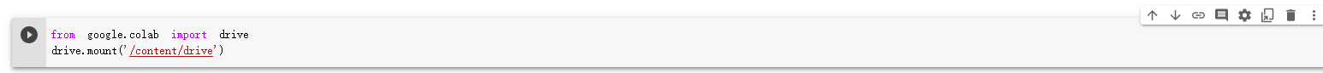
Moving and Creating a New Code Block
You can create a new code block by clicking on +Code(程式碼) on the top
Move cell up
Move cell down
Delete cell

Slide 10
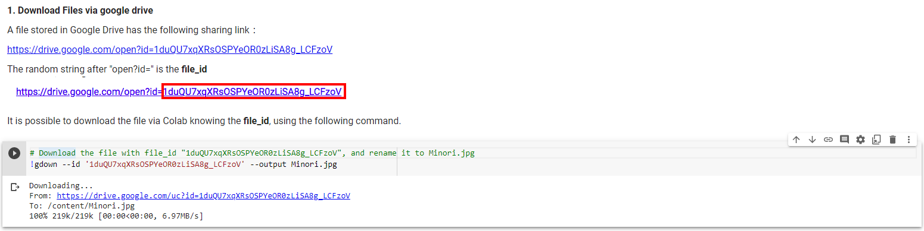
Executing Code Block
Click on the play button to execute the code block. This code downloads a file from google drive

Slide 11
Introduction
You can type python code in the code block, or use a leading exclamation mark ! to change the code block to treating the input as a shell script
import numpy
import math python
…
!ls -l
shell script

Slide 12
Introduction
Exclamation mark (!) starts a new shell, does the operations, and then kills that shell, while percentage (%) affects the process associated with the notebook, and it is called a magic function.
Use % instead of ! for cd(change directory) command

Slide 13
Useful Linux Commands (in Colab)
ls : List all files in the current directory
ls -l : List all files in the current directory with more detail
pwd : Output the working directory
mkdir <dirname> : Create a directory named <dirname>
cd <dirname> : Move to directory named <dirname>
gdown : Download files from google drive
wget : Download files from the internet
python <python_file> : Executes a python file

Slide 14
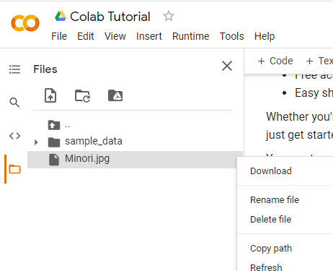
File Structure
Clicking on the folder icon will give you the visuallization of the file structure
There should be a jpg file, if you do not see it, click the refresh button
The file is temporarily stored, and will be removed once you end your session. You can download the file to your local directory.
refresh

Slide 15
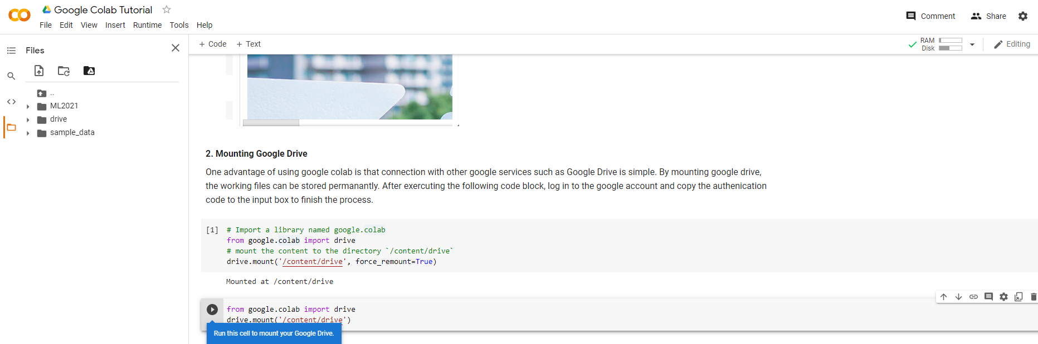
Mounting Google Drive
Execute the code block with drive.mount(‘/content/drive’)
or click on the Google Drive icon, a code block will appear

Slide 16
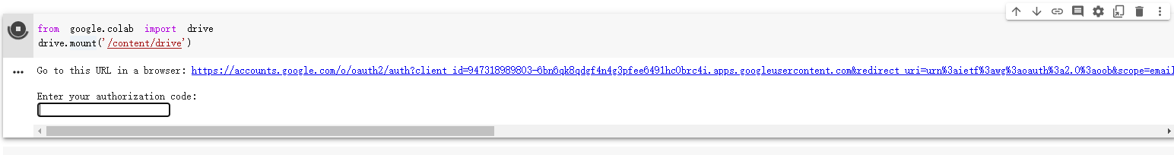
Mounting Google Drive
Sign in to your google account to get the authorization code. Enter the authorization code in the box below.

Slide 17
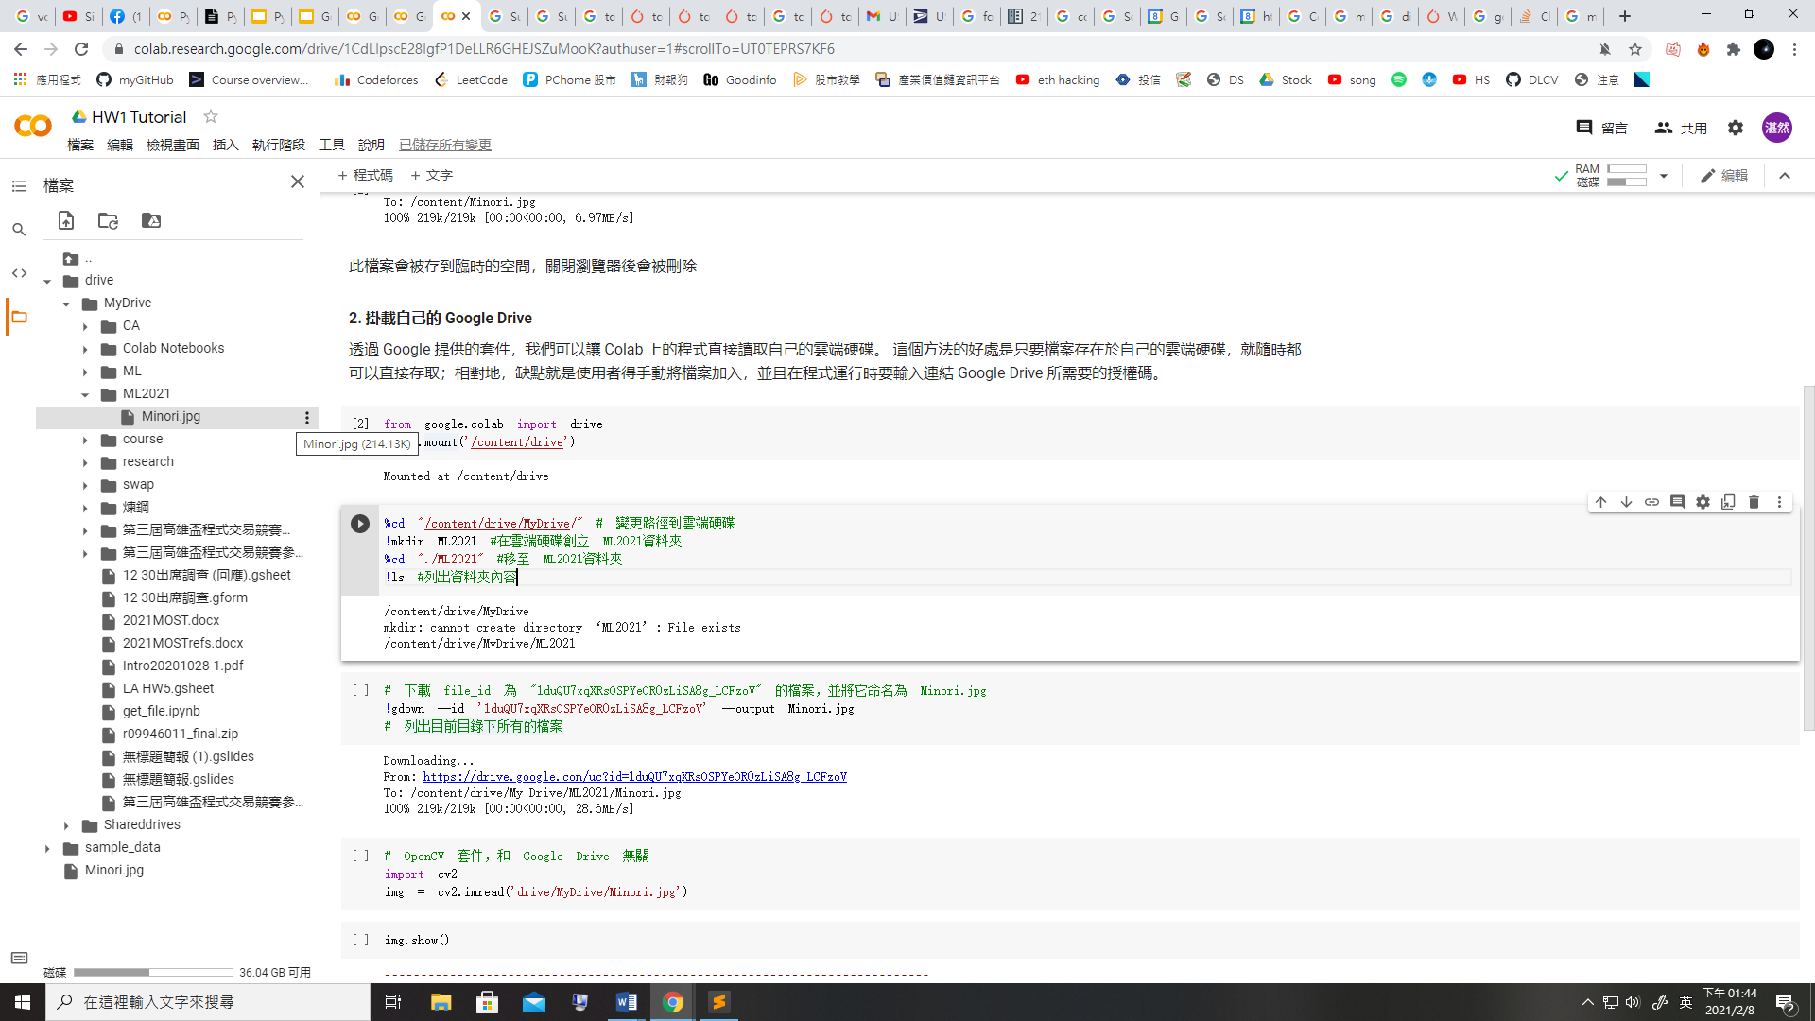
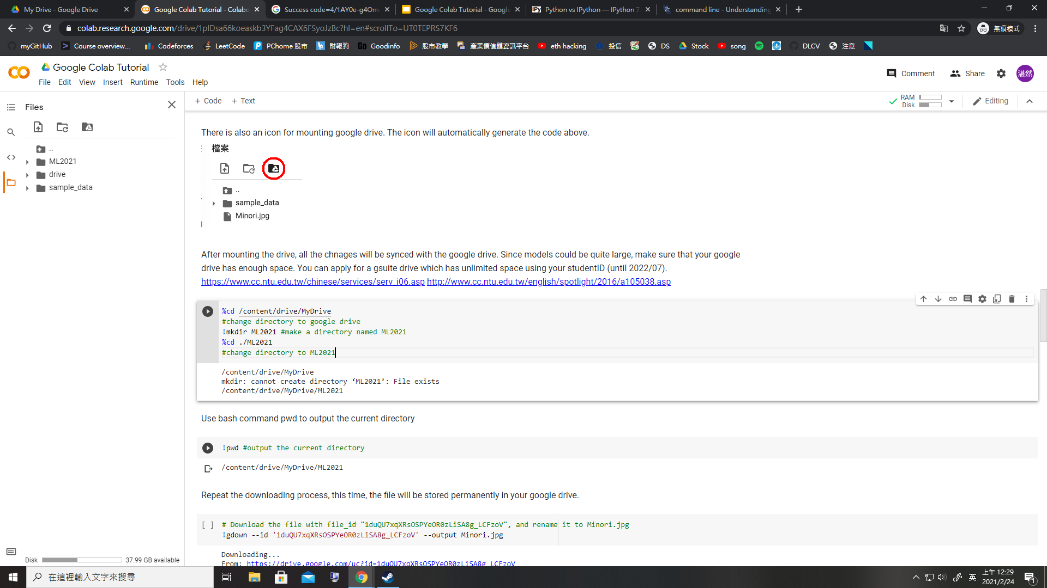
Mounting Google Drive
Execute the following three code blocks in order
This will download the image to your google drive, so you can access it later

Slide 18
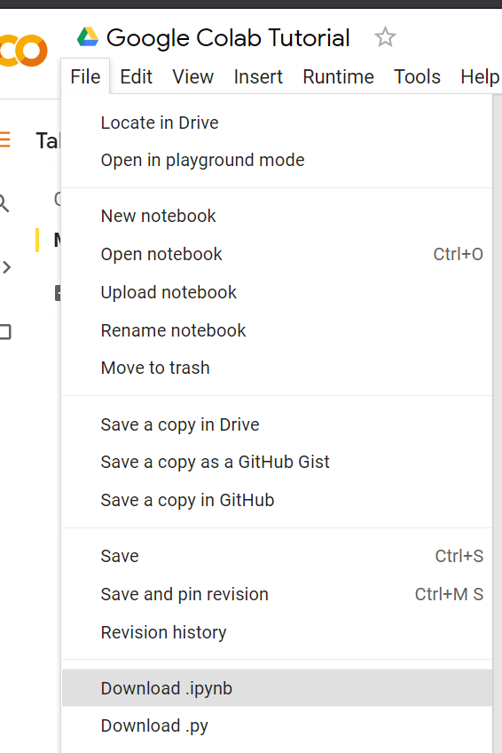
Saving Colab
You can download the ipynb file to your local device ( File > Download .ipynb), or save the colab notebook to your google drive (File > Save a copy in Drive).

Slide 19
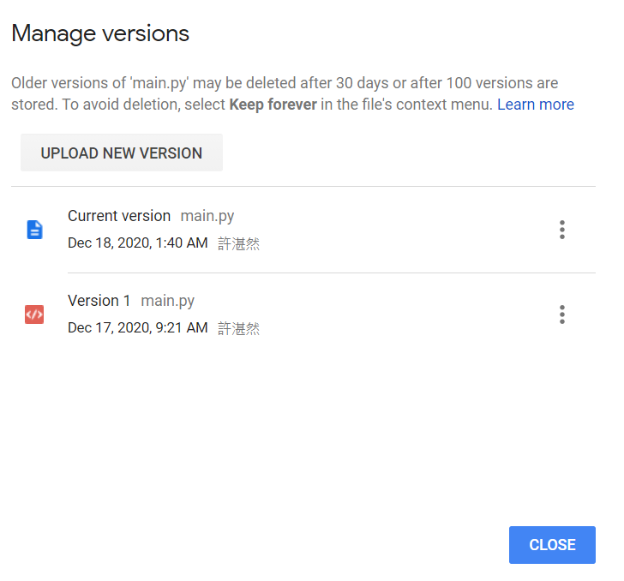
Recovering Files in Google Drive
Right Click on File > Manage Versions (版本管理) to recover old files that have been accidentally overwritten.

Slide 20
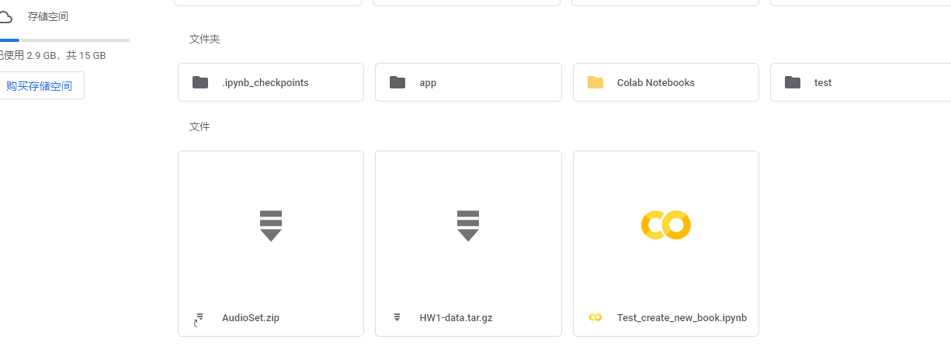
创建notebook

Slide 21
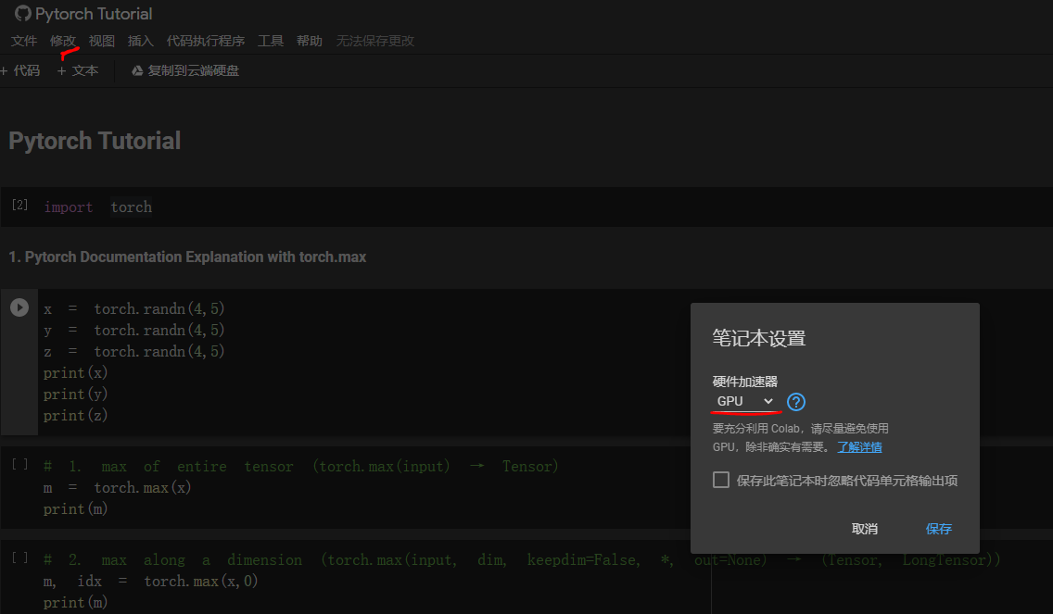
指定notebook 运行环境

Slide 22
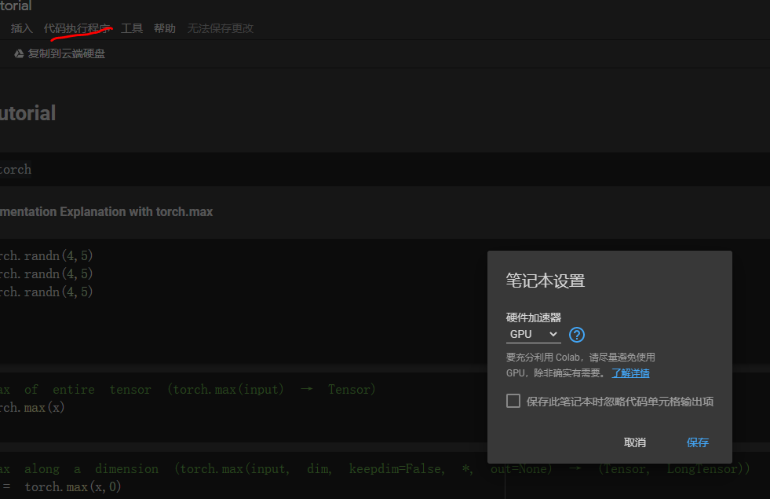
检查当前使用环境

Slide 23
GPU CPU之间切换

Slide 24
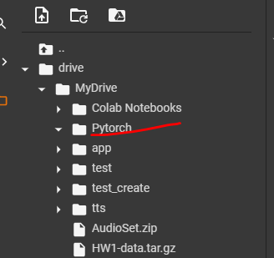
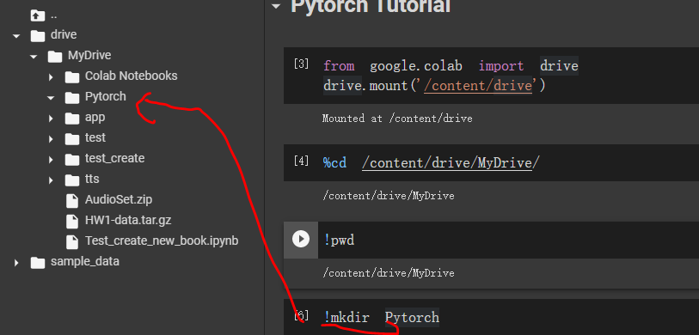
创建文件夹

Slide 25
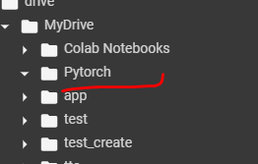
上传数据

Slide 26
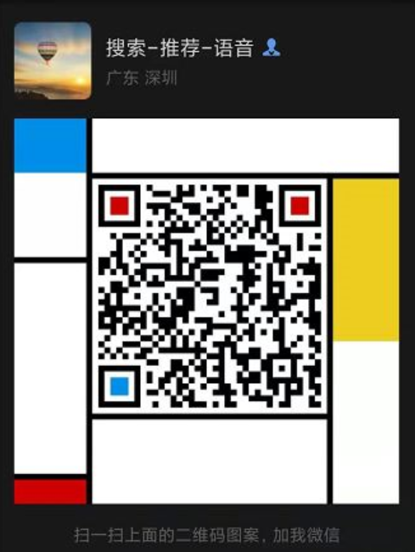
加我微信进李宏毅老师ML&DL打卡群
学生 备注格式： 昵称-学校-研究方向
有工作备注格式： 昵称-单位-研究方向
没备注不会通过额

Slide 27
作业1 colab运行演示
李宏毅老师机器学习深度学习课程https://www.bilibili.com/video/BV1zA411K7en?from=search&seid=13120721475898471221
作业1材料 homework_code
https://github.com/wolfparticle/machineLearningDeepLearning
Google colab使用PPT
https://github.com/wolfparticle/googlecolabtutorial

Slide 28
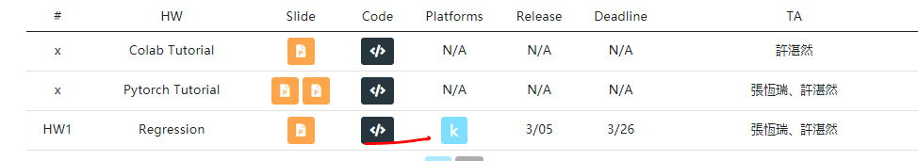
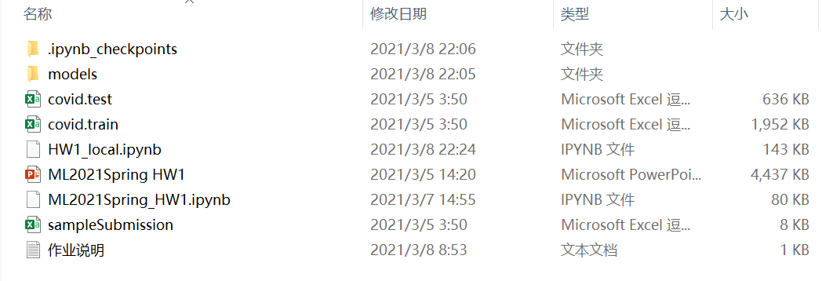
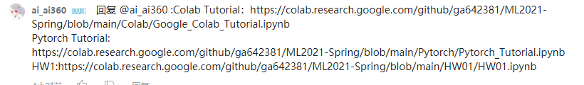
作业1文件
https://speech.ee.ntu.edu.tw/~hylee/ml/2021-spring.html
https://github.com/wolfparticle/machineLearningDeepLearning
https://www.bilibili.com/video/BV1zA411K7en?from=search&seid=13120721475898471221

Slide 29
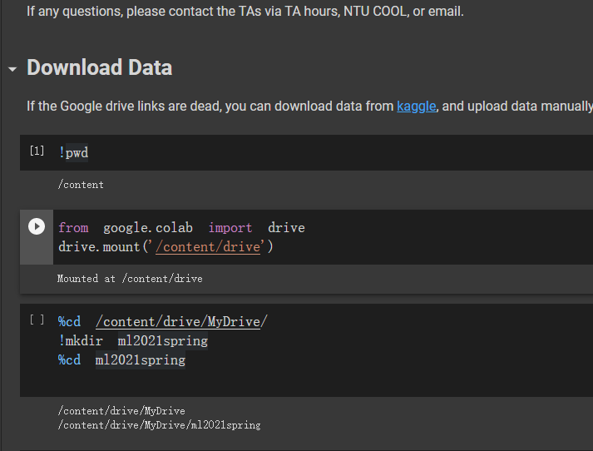
挂载驱动创建作业目录

Slide 30
Saving Colab
You can download the ipynb file to your local device ( File > Download .ipynb), or save the colab notebook to your google drive (File > Save a copy in Drive).

Slide 31
保存文件到作业目录

Slide 32
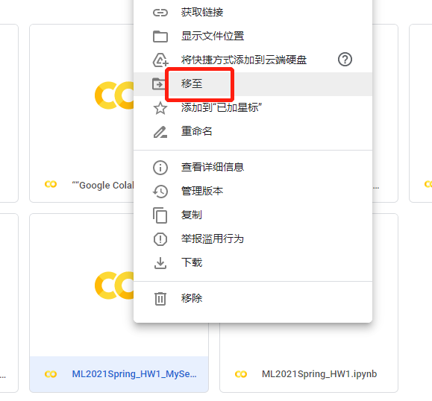
移动ipynb文件

Slide 33
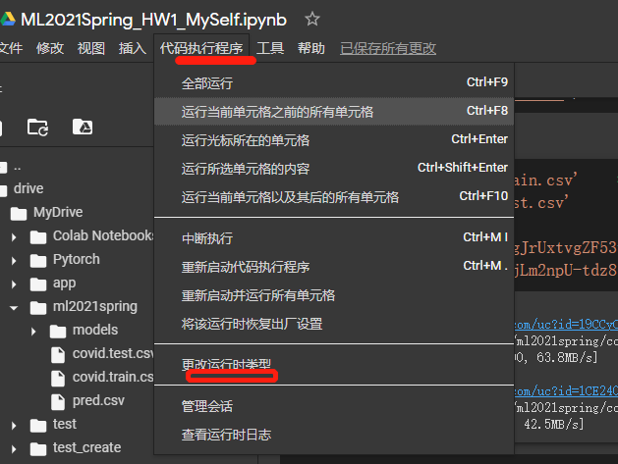
检查环境

Slide 34
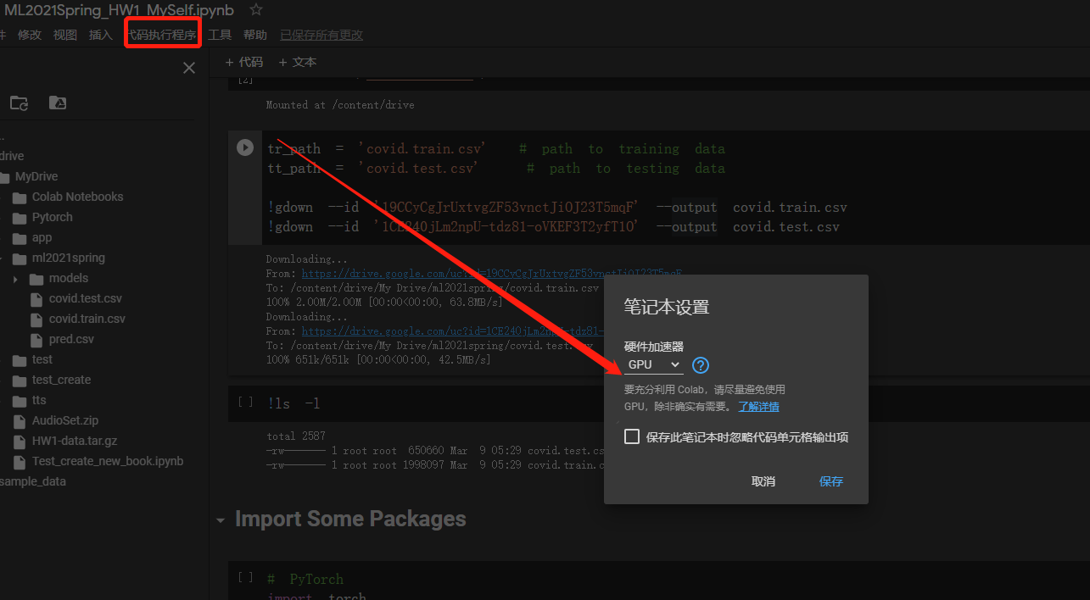
切换GPU环境

Slide 35
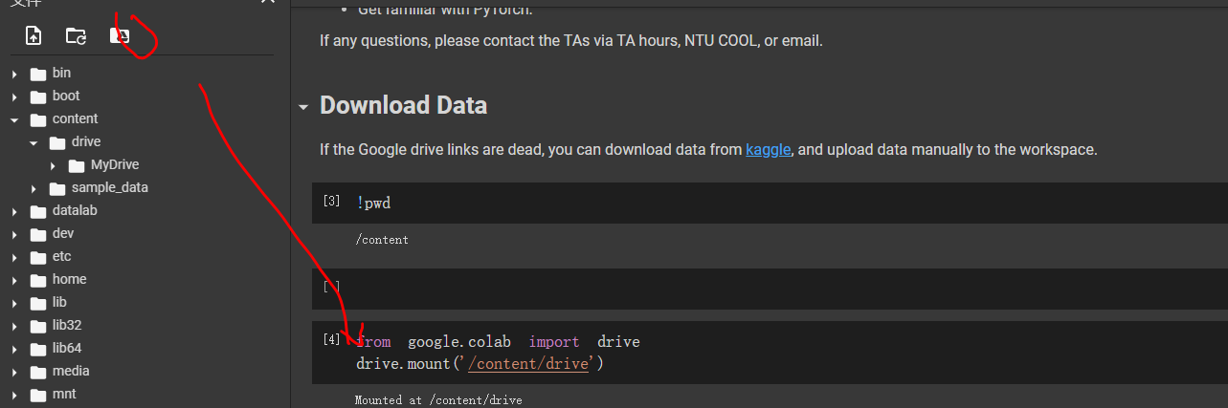
挂载驱动

Slide 36
运行单元格
快捷方式 shift_+enter

Slide 37
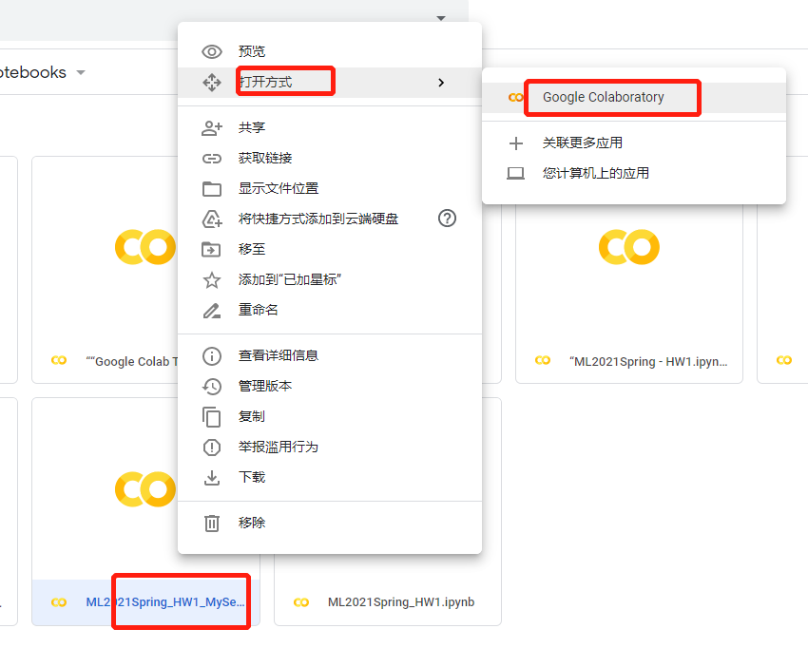
重新运行自己ipynb文件

Slide 38
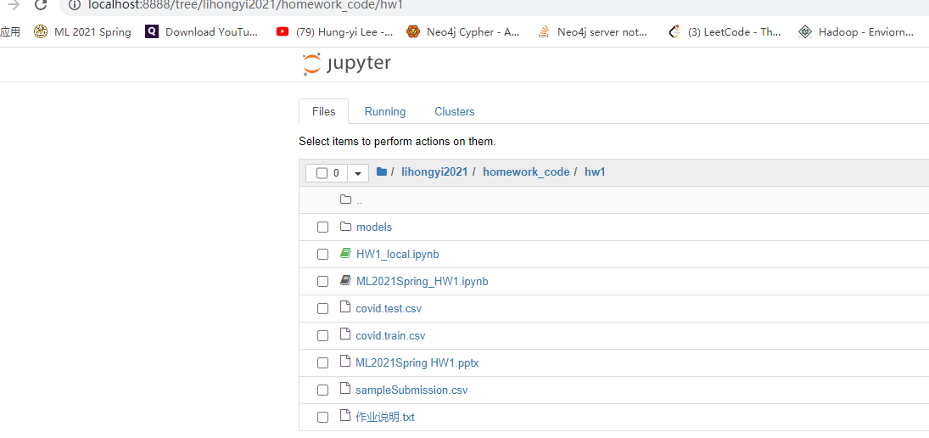
本地运行

Slide 39
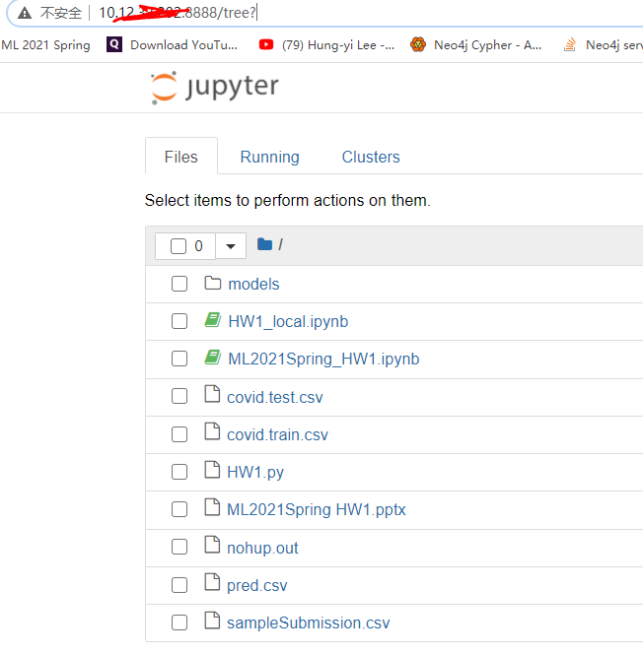
本地远程文件

Slide 40
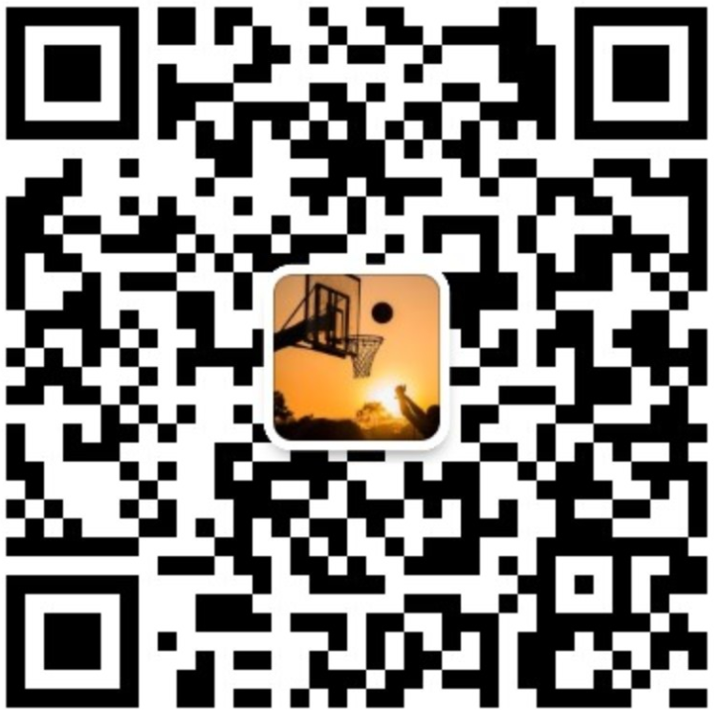
远程运行
公众号
微信
配置jupyter notebook 远程访问 https://mp.weixin.qq.com/s/wS5JqHoMDZX5xlGQjO9fEQ

Slide 41
结束
谢谢观看，欢迎点赞

